Slide 1
Sets
Presentation for use with the textbook Data Structures and Algorithms in Java, 6th edition, by M. T. Goodrich, R. Tamassia, and M. H. Goldwasser, Wiley, 2014

Slide 2
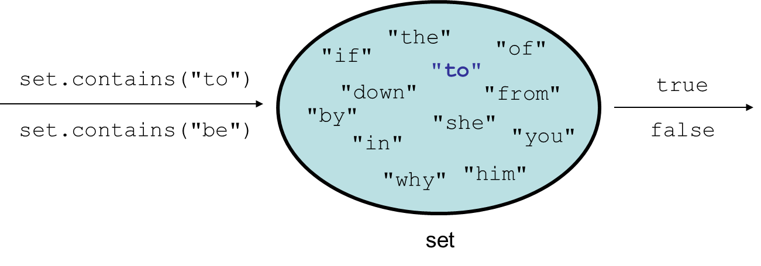
Definitions
A set is an unordered collection of elements, without duplicates that typically supports efficient membership tests.
We don't think of a set as having indexes; we just add things to the set in general and don't worry about order

Slide 3
Set implementation
in Java, sets are represented by Set interface in java.util
Set is implemented by HashSet and TreeSet classes
HashSet: implemented using a "hash table" array; very fast: O(1) for all operations elements are stored in unpredictable order
TreeSet: implemented using a "binary search tree"; pretty fast: O(log N) for all operations elements are stored in sorted order
LinkedHashSet: O(1) but stores in order of insertion

Slide 4
Sets and ordering
HashSet : elements are stored in an unpredictable order
Set<String> names = new HashSet<String>();
names.add("Jake");
names.add("Robert");
names.add("Marisa");
names.add("Kasey");
System.out.println(names);
// [Kasey, Robert, Jake, Marisa]
TreeSet : elements are stored in their "natural" sorted order
Set<String> names = new TreeSet<String>();
...
// [Jake, Kasey, Marisa, Robert]
LinkedHashSet : elements stored in order of insertion
Set<String> names = new LinkedHashSet<String>();
...
// [Jake, Robert, Marisa, Kasey]

Slide 5
Set methods
List<String> list = new ArrayList<String>();
...
Set<Integer> set = new TreeSet<Integer>(); // empty
Set<String> set2 = new HashSet<String>(list);
can construct an empty set, or one based on a given collection.
add(value) | adds the given value to the set
contains(value) | returns true if the given value is found in this set
remove(value) | removes the given value from the set
clear() | removes all elements of the set
size() | returns the number of elements in list
isEmpty() | returns true if the set's size is 0
toString() | returns a string such as "[3, 42, -7, 15]"

Slide 6
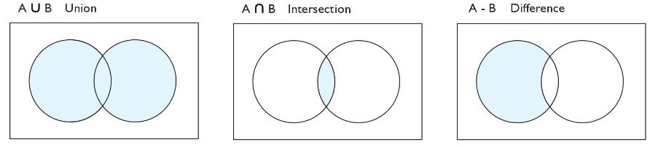
Set operations
addAll
retainAll
removeAll
addAll(collection) | adds all elements from the given collection to this set
containsAll(coll) | returns true if this set contains every element from given set
equals(set) | returns true if given other set contains the same elements
iterator() | returns an object used to examine set's contents (seen later)
removeAll(coll) | removes all elements in the given collection from this set
retainAll(coll) | removes elements not found in given collection from this set
toArray() | returns an array of the elements in this set

Slide 7
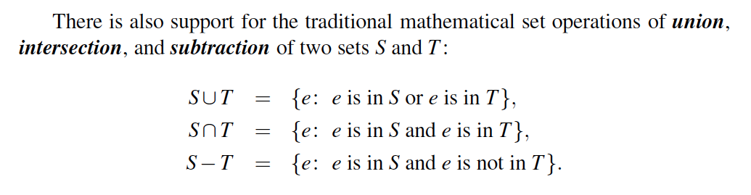
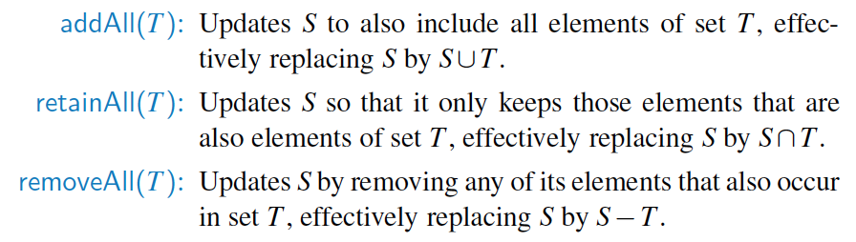
Set Operation Details

Slide 8
The "for each" loop
for (type name : collection) {
statements;
}
Provides a clean syntax for looping over the elements of a Set, List, array, or other collection
Set<Double> grades = new HashSet<Double>();
...
for (double grade : grades) {
System.out.println("Student's grade: " + grade);
}
needed because sets have no indexes; can't get element i

Slide 9
Maps
Presentation for use with the textbook Data Structures and Algorithms in Java, 6th edition, by M. T. Goodrich, R. Tamassia, and M. H. Goldwasser, Wiley, 2014

Slide 10
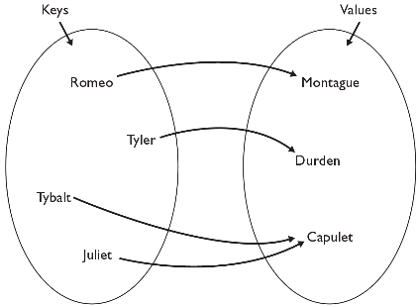
The Map ADT
map: Holds a set of unique keys and a collection of values, where each key is associated with one value.
a.k.a. "dictionary", "associative array", "hash"
basic map operations:
put(key, value ): Adds a mapping from a key to a value.
get(key ): Retrieves the value mapped to the key.
remove(key ): Removes the given key and its mapped value.
myMap.get("Juliet") returns "Capulet"

Slide 11
Maps
Multiple entries with the same key are not allowed
Applications:
address book
student-record database

Slide 12
Map implementation
in Java, maps are represented by Map interface in java.util
Map is implemented by the HashMap and TreeMap classes
HashMap: implemented using an array called a "hash table"; extremely fast: O(1) ; keys are stored in unpredictable order
TreeMap: implemented as a linked "binary tree" structure; very fast: O(log N) ; keys are stored in sorted order
A map requires 2 type parameters: one for keys, one for values.
// maps from String keys to Integer values
Map<String, Integer> votes = new HashMap<String, Integer>();

Slide 13
Map methods
put(key, value) | adds a mapping from the given key to the given value; if the key already exists, replaces its value with the given one
get(key) | returns the value mapped to the given key (null if not found)
containsKey(key) | returns true if the map contains a mapping for the given key
remove(key) | removes any existing mapping for the given key
clear() | removes all key/value pairs from the map
size() | returns the number of key/value pairs in the map
isEmpty() | returns true if the map's size is 0
toString() | returns a string such as "{a=90, d=60, c=70}"
keySet() | returns a set of all keys in the map
values() | returns a collection of all values in the map
putAll(map) | adds all key/value pairs from the given map to this map
equals(map) | returns true if given map has the same mappings as this one

Slide 14
Using maps
A map allows you to get from one half of a pair to the other.
Remembers one piece of information about every index (key).
Later, we can supply only the key and get back the related value:
Allows us to ask: What is Marty's phone number?
// key value
put("Marty", "206-685-2181")
Map
get("Marty")
Map
"206-685-2181"

Slide 15
A Simple List-Based Map
We can implement a map using an unsorted list
We store the items of the map in a list S (based on a doublylinked list), in arbitrary order
header
nodes/positions
trailer
9
c
6
c
5
c
8
c
entries

Slide 16
Performance of a List-Based Map
Performance:
put takes O(1) time since we can insert the new item at the beginning or at the end of the sequence
get and remove take O(n) time since in the worst case (the item is not found) we traverse the entire sequence to look for an item with the given key
The unsorted list implementation is effective only for maps of small size or for maps in which puts are the most common operations, while searches and removals are rarely performed (e.g., historical record of logins to a workstation)

Slide 17
Maps vs. sets
A set is like a map from elements to boolean values.
Set: Is "Marty" found in the set? (true/false)
Map: What is "Marty" 's phone number?
"Marty"
Set
true
false
"Marty"
Map
"206-685-2181"

Slide 18
keySet and values
keySet method returns a Set of all keys in the map
can loop over the keys in a for each loop
can get each key's associated value by calling get on the map
Map<String, Integer> ages = new TreeMap<String, Integer>();
ages.put("Marty", 19);
ages.put("Geneva", 2); // ages.keySet() returns Set<String>
ages.put("Vicki", 57);
for (String name : ages.keySet()) { // Geneva -> 2
int age = ages.get(age); // Marty -> 19
System.out.println(name + " -> " + age); // Vicki -> 57
}
values method returns a collection of all values in the map
can loop over the values in a for each loop
no easy way to get from a value to its associated key(s)

Slide 19
Problem: opposite mapping
It is legal to have a map of sets, a list of lists, etc.
Suppose we want to keep track of each TA's GPA by name.
Map<String, Double> taGpa = new HashMap<String, Double>();
taGpa.put("Jared", 3.6);
taGpa.put("Alyssa", 4.0);
taGpa.put("Steve", 2.9);
taGpa.put("Stef", 3.6);
taGpa.put("Rob", 2.9);
...
System.out.println("Jared's GPA is " + taGpa.get("Jared")); // 3.6
This doesn't let us easily ask which TAs got a given GPA.
How would we structure a map for that?

Slide 20
Reversing a map
We can reverse the mapping to be from GPAs to names.
Map<Double, String> taGpa = new HashMap<Double, String>();
taGpa.put(3.6, "Jared");
taGpa.put(4.0, "Alyssa");
taGpa.put(2.9, "Steve");
taGpa.put(3.6, "Stef");
taGpa.put(2.9, "Rob");
...
System.out.println("Who got a 3.6? " +
taGpa.get(3.6)); // ???
What's wrong with this solution?
More than one TA can have the same GPA.
The map will store only the last mapping we add.

Slide 21
Proper map reversal
Really each GPA maps to a collection of people.
Map<Double, Set<String>> taGpa = new HashMap<Double, Set<String>>();
taGpa.put(3.6, new TreeSet<String>());//initialize set for GPA
taGpa.get(3.6).add("Jared");
taGpa.put(4.0, new TreeSet<String>());
taGpa.get(4.0).add("Alyssa");
taGpa.put(2.9, new TreeSet<String>());
taGpa.get(2.9).add("Steve");
taGpa.get(3.6).add("Stef");
taGpa.get(2.9).add("Rob");
...
System.out.println("Who got a 3.6? " + taGpa.get(3.6)); // [Jared, Stef]
must be careful to initialize the set for a given GPA before adding

